Slide 1

Application Assisted Popcorn Preparation
Students: Igor Berendorf
Or Zamir
Supervisor: Roee Mazor
Semester: Spring 2017
NSSL Laboratory 25/10/17

Slide 2
Project Goals
Exploring Sound Analysis Methods
Real-time Signal Processing
Android Application Development
Making Top-Notch Popcorn
Notes:
הצגת מטרת הפרויקט

Slide 3
Problem Characteristics
510 Popcorn Kernels Per Bag
Pops’ Width ~20ms
Distribution of Pops Over Time:
Notes:
הצגה של נתוני שקית פופקורן
המלצה

Slide 4
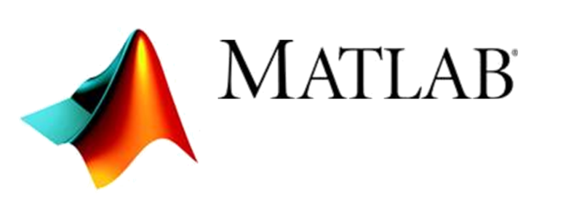
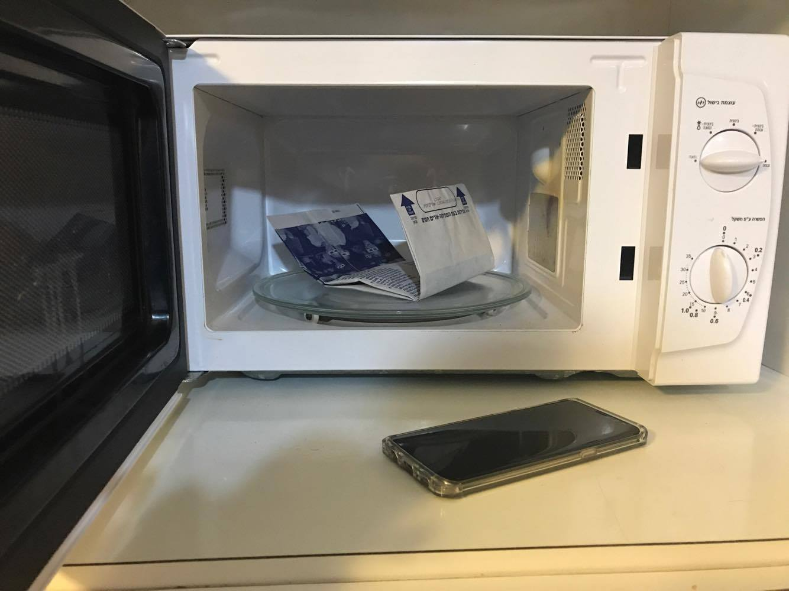

Work Environment

Slide 5
Challenges
Reliable Pop Detection
Application Development and User Experience
When is the popcorn ready?
Notes:
הצגת מטרת הפרויקט

Slide 6
Recordings Data Set
10 Full Recordings ~4min Each, both high power and low power
Manually identifying pops
Empiric pop distribution by 4 second bins

Slide 7
Pop Detection
Five pop detection methods tested
Two selected for porting to Java/Android
Precision | Recall | Method
98.0% | 85.3% | Zamir-Berendorf (Derivative)
97.2% | 79.9% | Moving Average
93.6% | 76.8% | Convolution
94.3% | 71.8% | Z-Score
92.1% | 67.2% | Energy Peak Detection

Slide 8
Zamir Berendorf
Expected noise calculated at the beginning of the recording
Apply second derivative to emphasize pops
Empiric threshold
Anything above threshold is considered a pop

Slide 9
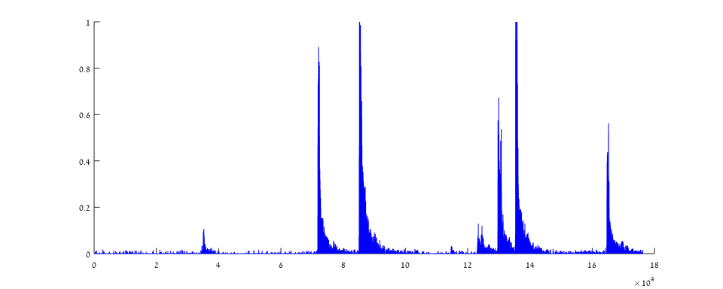
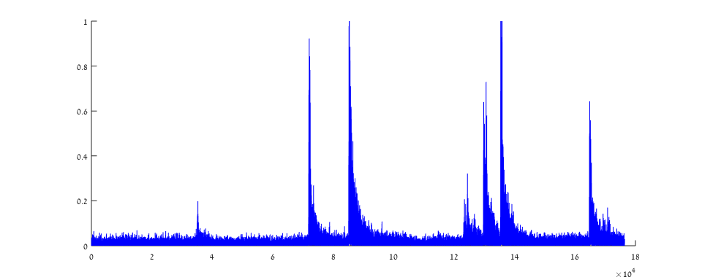
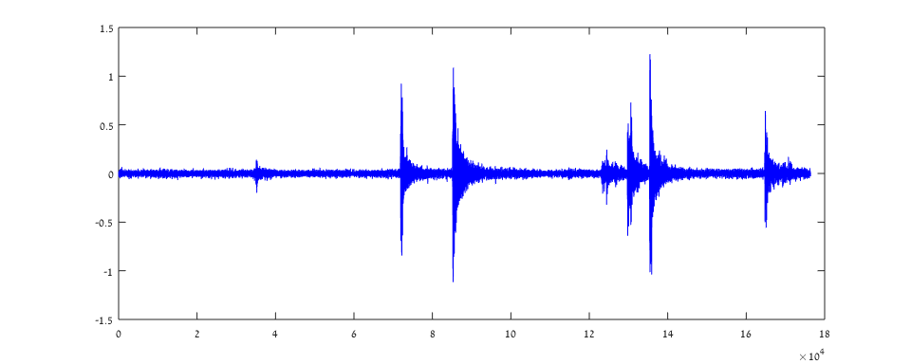
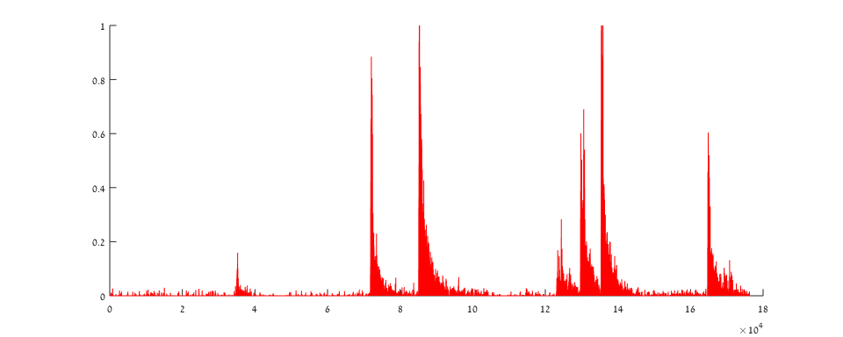
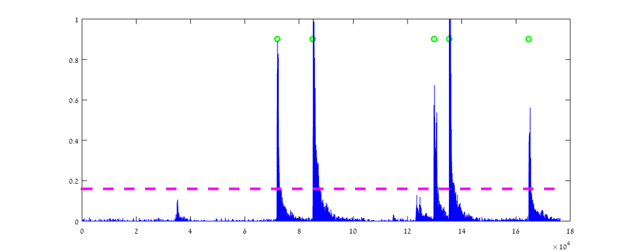
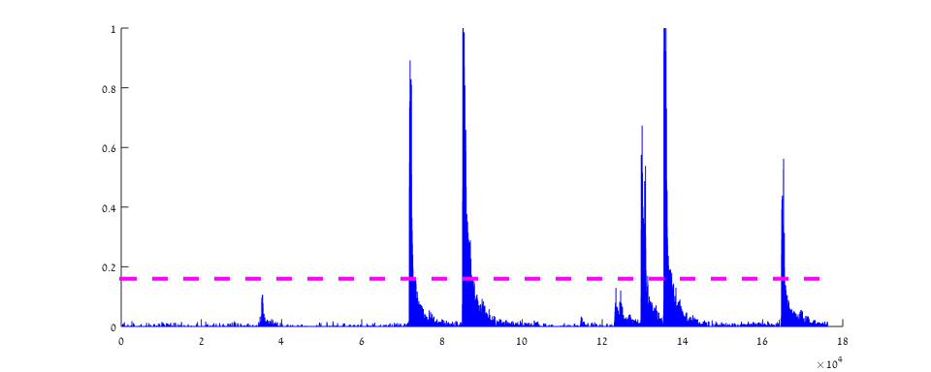
Original Signal
Zamir Berendorf
Mark
Double Derivative
Noise Removal
Absolute
Apply Threshold
Wanted signal remained about the same
Unwanted signal cut by 30%-50%
Amplitude
Samples x10^4

Slide 10
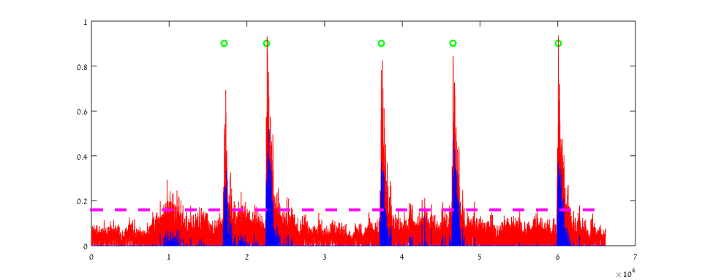
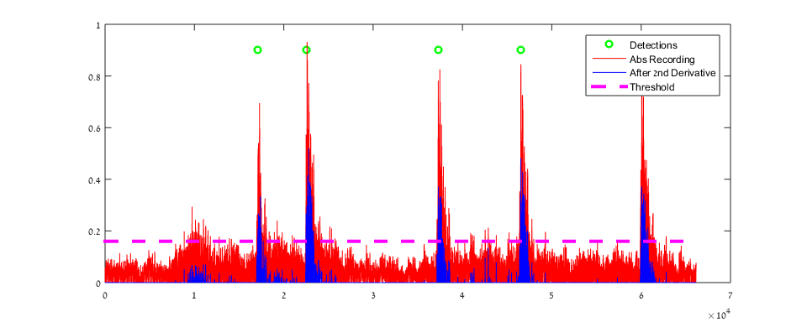
Zamir Berendorf – Noisy Signal
Amplitude
Samples x10^4

Slide 11
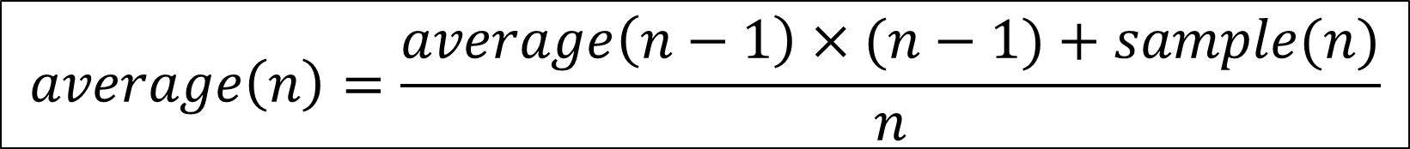
Moving Average
Ongoing average calculation
Empiric factor
Anything above threshold is a pop
$$average\left(n\right)=\frac{average\left(n−1\right)×(n−1)+sample(n)}{n}$$
$$Thresh(n)=factor ×average(n)$$
Notes:
לא דורש זכרון נוסף
עיבוד מידע מאוד קל – ולכן מהיר ולא זולל משאבים
החסרונות רלוונטיים בעיקר לתחילה של חלון – גם הרעש וגם פספוס הפצפוצים (Small interval…)

Slide 12
Original Signal
Moving Average
Absolute
Current Average
Mark
Amplitude
Samples x10^4
Notes:
לא דורש זכרון נוסף
עיבוד מידע מאוד קל – ולכן מהיר ולא זולל משאבים
החסרונות רלוונטיים בעיקר לתחילה של חלון – גם הרעש וגם פספוס הפצפוצים (Small interval…)

Slide 13
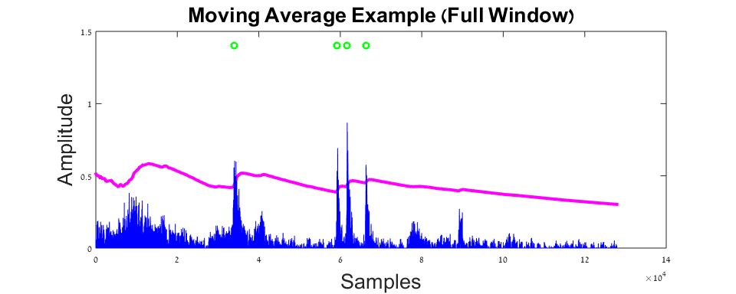
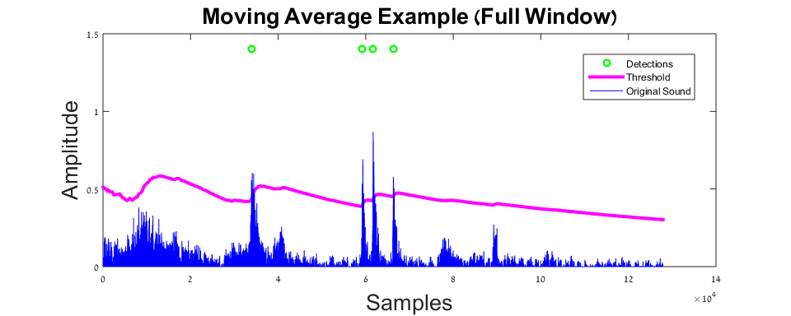
Moving Average – Noisy Signal
Amplitude
Samples x10^4

Slide 14
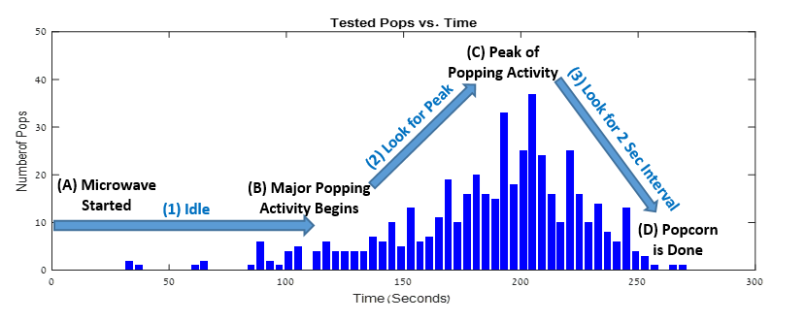
Detection Flow Diagram
Idle
Gaussian Peak
Interval

Slide 15
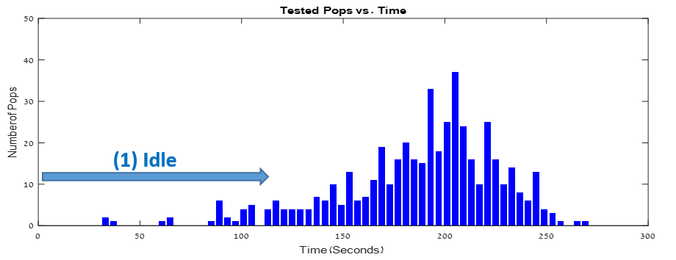
Detection Stages - Idle
Idle
Gaussian Peak
Interval
Avoid unnecessary calculations and false identifications
Duration based on power setting

Slide 16
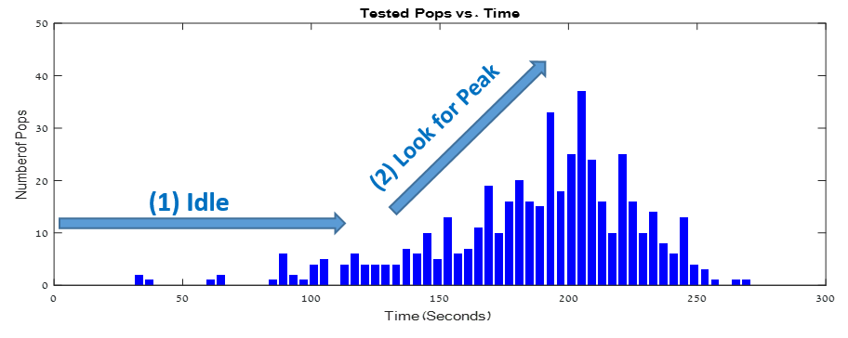
Detection Stages - Peak
Idle
Gaussian Peak
Interval
Find the pop-distribution peak
Popcorn is ready only after peak is reached
Pop detection algorithm depends on power setting

Slide 17
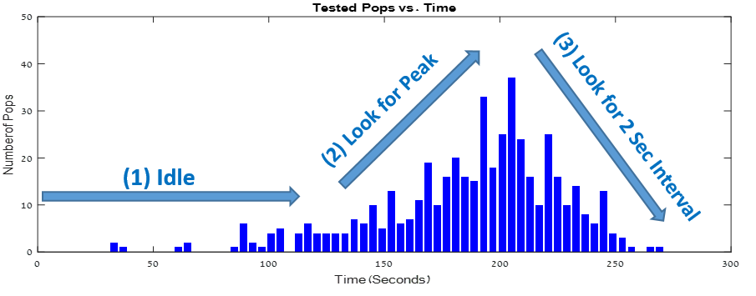
Detection Stages - Interval
Idle
Gaussian Peak
Interval
Look for interval longer than 2 seconds
When the desired interval is found – announce “DONE”
Pop detection algorithm depends on power setting

Slide 18
The Application
Multi-threaded
Modular
User friendly
User proof
Requires Android 5.0 LOLLIPOP
Notes:
עכשיו ניתן להם להתעסק עם האפליקציה

Slide 19
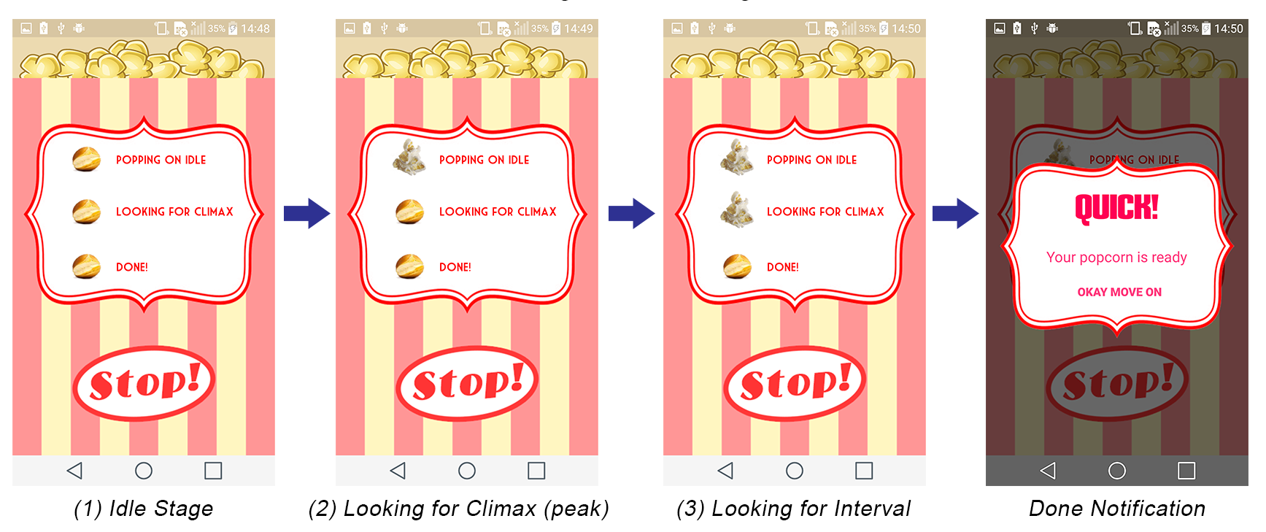
Detection Stages Graphics

Slide 20
Video Here
Removed from presentation because it weights 130MB…

Slide 21
Application Results
Low Power Microwave
Weighted Abs Distance | Precision | Recall | Method
56.2 | 98.7% | 94.9% | Zamir-Berendorf (Derivative)
81.2 | 90.5% | 89.5% | Moving Average
High Power Microwave
Weighted Abs Distance | Precision | Recall | Method
23.7 | 98.9% | 94.2% | Moving Average
38.4 | 93.2% | 93.6% | Zamir-Berendorf (Derivative)
*Weighted abs distance of the detected pops distribution from the measured distribution
*Results ignore double detections of the same pop

Slide 22
In Conclusion
Application works in semi-quiet environments
Tested in white noise environments
Requires human presence
What’s next?
Improved noise filtering using Machine Learning
IoT integration

Slide 23

Thank You!

